Slide 1


Project 1: ETL Workflow Automation
Performed by Ansh Ranjan & Sarvesh Sharma

Slide 2
Objective
To automate an end-to-end ETL pipeline for processing and analyzing data using Azure cloud services.
The pipeline follows the Bronze, Silver, and Gold layered architecture to handle raw data ingestion, transformation, and aggregation efficiently.

Slide 3
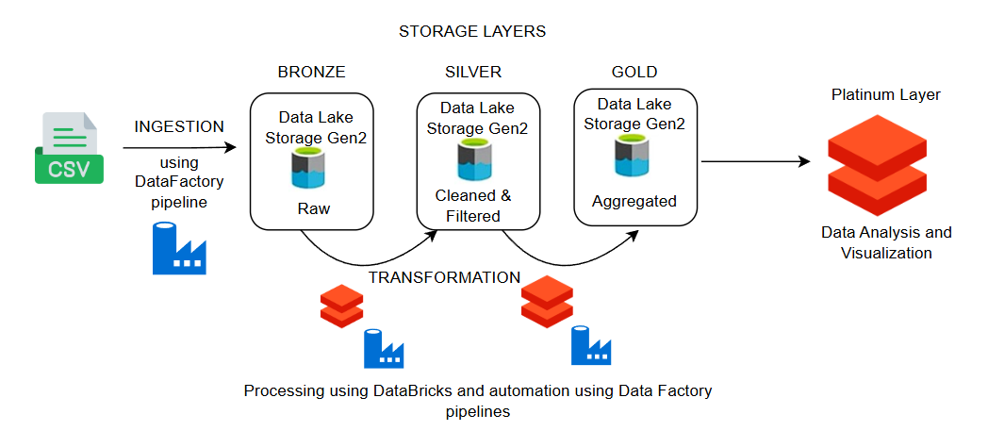
Architecture

Slide 4
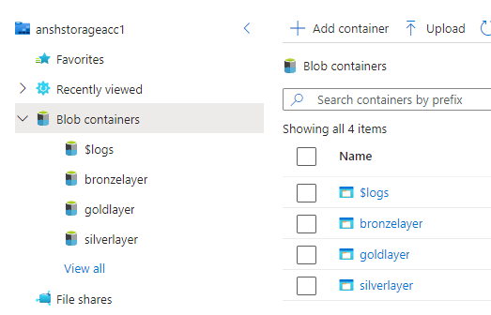
Storage
Create a storage account with 4 containers
Rawdata : Raw data of outside source
Bronzelayer : Ingested raw data
Silverlayer : Cleaned, filtered and transformed data
Goldlayer : Data to use business logic on

Slide 5
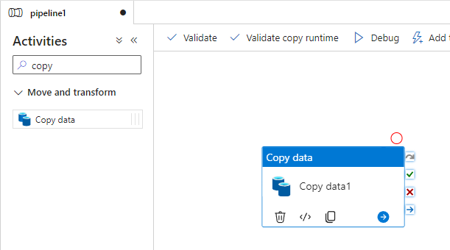
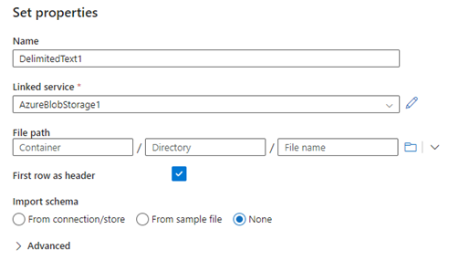
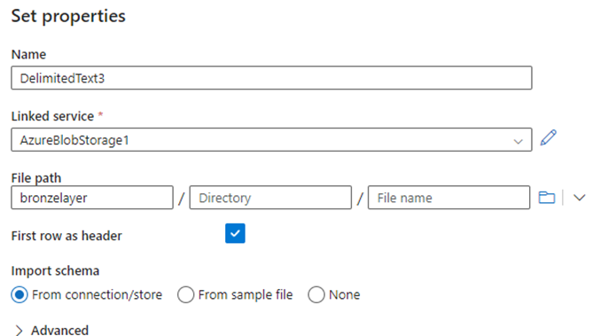
Ingestion – Bronze Layer
Create a DataFactory pipeline to read data from source (rawdata container) and ingest it into our Bronze Layer
Select the source and sink
Validate, Publish and Trigger the pipeline
Activity Source Sink

Slide 6
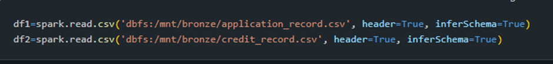
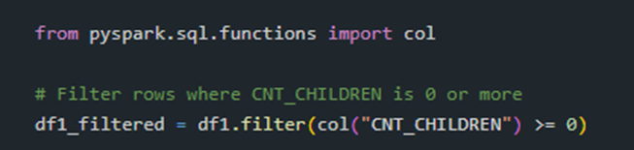

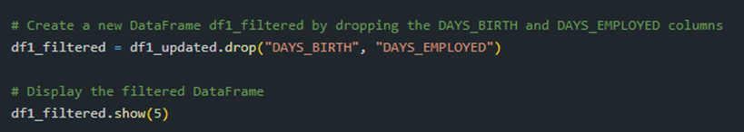
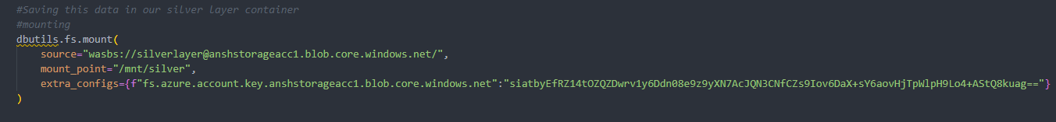
Cleaning – Silver Layer
Load Data from bronzelayer container
Drop Null values
Drop Duplicated
Filter invalid data
Correct the data in Days_Birth and Days_Employed
Create a new column Age and Years of Employment
Dropping unnecessary columns
Load the data in Silverlayer container

Slide 7
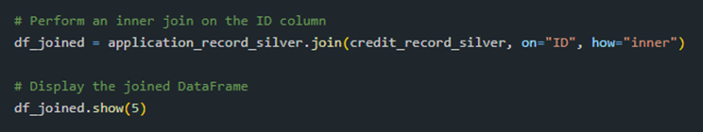
Gold Layer
Extract
Read data from Silverlayer
Perform
Perform a join operation to combine the 2 datasets on the common column ID
Load
Load the data in Goldlayer container

Slide 8

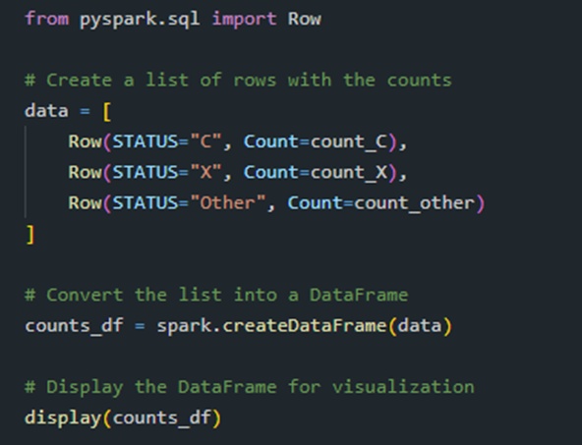
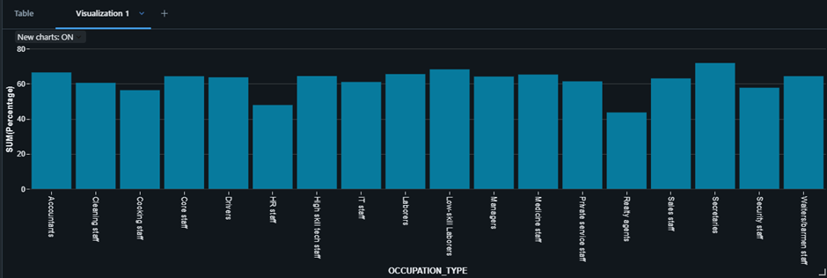
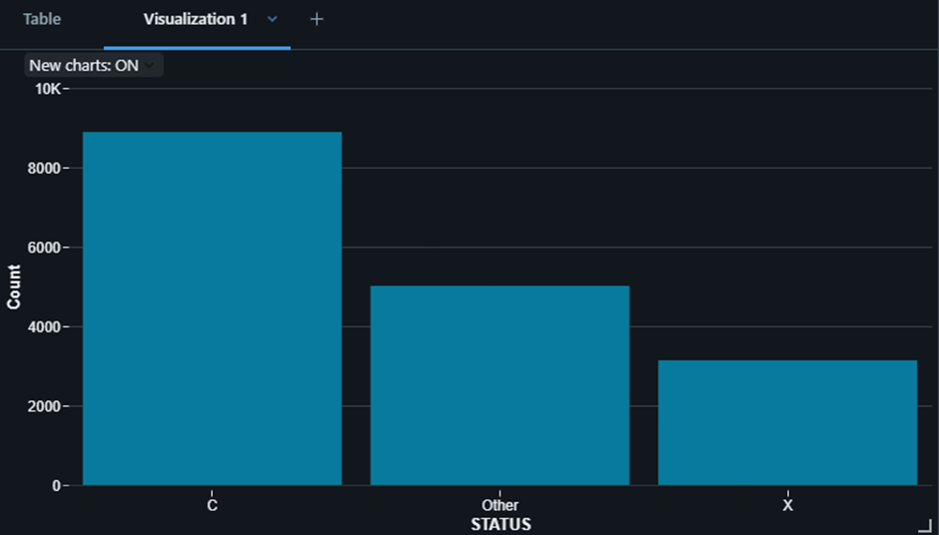
Platinum Layer
Filter data to only consider the last month's status
Visualize the counts using PySpark
Insights by Occupation Type
Average statistics (Age, Employment Years, Income)

Slide 9
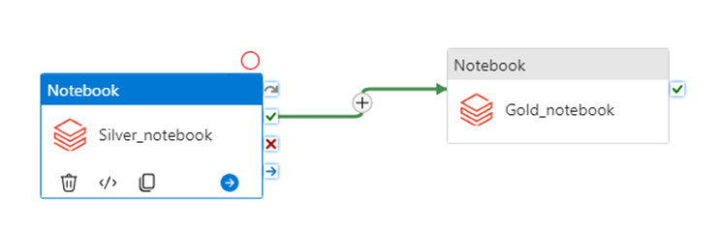
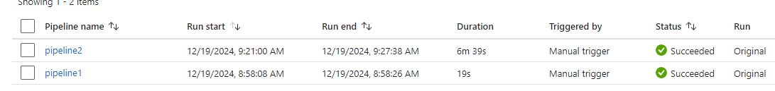
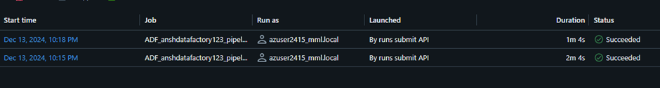
Azure DataFactory Pipeline
The notebooks we created do not need to be run manually
We can automate the execution of the notebook by using Azure DataFactory
- Create a pipeline - Grab 2 notebook activity blocks, one for silver, gold each - Link them by ‘on-success’ condition - Validate and Publish the pipeline - Trigger the execution - check the output in Job Run tab of databrick workspace

Slide 10
Results
Final Dataset:
Stored in the Gold Layer as a Parquet file within the goldlayer container.
Contains a unified view of user application records and credit history, ready for advanced analytics and predictive modeling.
Enables seamless access for business intelligence, reporting, and further processing

Slide 11
Conclusion
Automated Workflow: Leveraged Azure Data Factory for orchestration and Databricks for Spark-based transformations.
Bronze Layer: Preserved the raw, unprocessed data for traceability.
Silver Layer: Cleaned and transformed the raw data, ensuring consistency and removing invalid or null records.
Gold Layer: Delivered an aggregated, feature-enhanced dataset optimized for analysis.
Successfully combined application_record.csv and credit_record.csv to build a robust analytical foundation.

Slide 12

Thank You

